Slide 1


Development of a prototype CRM platform using Amazon Web Services [Company name, Redacted]
Group Members Stuart Salvara, [team member names, redacted]
Client Delegates [client name, redacted]
Date of Presentation. - 21st August 2024

Slide 2
Introduction
We have been given the task by the client to create a prototype web application for a new CRM system focusing on functionality.
CRM contents:
o Front Page
o Table of Contents
o Database
o IAM
Notes:
What is the business problem to be addressed in this Industry Project? CGI is an organisation possessing a vast clientele. In order to manage them effectively, they wish to build a platform that would automate processes that have so far been carried out manually and increase their transparency and efficiency, saving valuable time and reducing any related costs considerably. What would an ideal solution to this problem involve? • The task here is to create a prototype web application that would serve as a proof-ofconcept for a new CRM system, which would incorporate a few basic pages, focusing primarily on the functionality and then on the appearance (which should follow our branding guidelines). • This prototype should be utilising AWS tools and resources (including AWS CloudFormation), which, based on your research, would be suitable for each one of the system’s components (e.g. storage, back-end functionality). • There will be no need to enquire about the data itself (you are more than welcome to create dummy data for testing), but instead focus on the creation of specific columns (one per category) for the following categories (not exhaustive list): o Name of the client o Contact information o Account history o Deals/opportunities o Calls Logo Emails log o Reminders/Alerts • Objectives • Create a CRM prototype with basic functionality: o Front Page o Table of Contents o Database o IAM • Provide supporting documentation explaining the development, cost and the reasoning behind selection of services and resources. Deliverables • Report • Presentation • Prototype’s files (e.g. code, solution architecture diagram, resources).

Slide 3

Team Leader – Stuart Salvara
Graduated from London Metropolitan University in 2003.
Having worked in finance for over 15 years and now hoping to move into a career in cloud computing upon bootcamp completion.
Research interests – Interested in technology, specifically cloud computing, finance, crypto currency and investing
Group 1 - Team Leader

Slide 4
Methodology
Stage | Actions
Research CRM Models | Studied existing CRM models like Salesforce to identify key functionalities for the proof-of-concept.
Determine Infrastructure Architecture | Decided on a three-tier architecture: Presentation layer, Logic layer, and Data layer.
Define Components of the Web Application | Identified necessary components: Subnets, VPC, NAT Gateway, EC2 instances, ALB, ASG.
Select AWS Services | Chose relevant AWS services: IAM, CloudFormation, Amazon RDS.
Cost Estimation and Monitoring | Estimated project costs and planned for post-deployment cost monitoring using AWS tools.
Notes:
We researched existing CRM models for example, (salesforce) to see what functionality already existed in other CRM models we could use for our proof-of-concept model.
We researched what type of infrastructure architecture would be best suited for our model (two-tier web application model or three-tier application model), and we decided to adopt a three tier-application model.
What components would make up the three web tier application? Subnets, VPC, NAT Gateway, EC2 instances, ALB (Application Loading Balancer), ASG (Auto Scaling Group) etc
What AWS services would we require? IAM, CloudFormation, Amazon RDS etc.
How could we estimate the cost of the project and how could we monitor the cost of the CRM post completion and being fully functional?

Slide 5
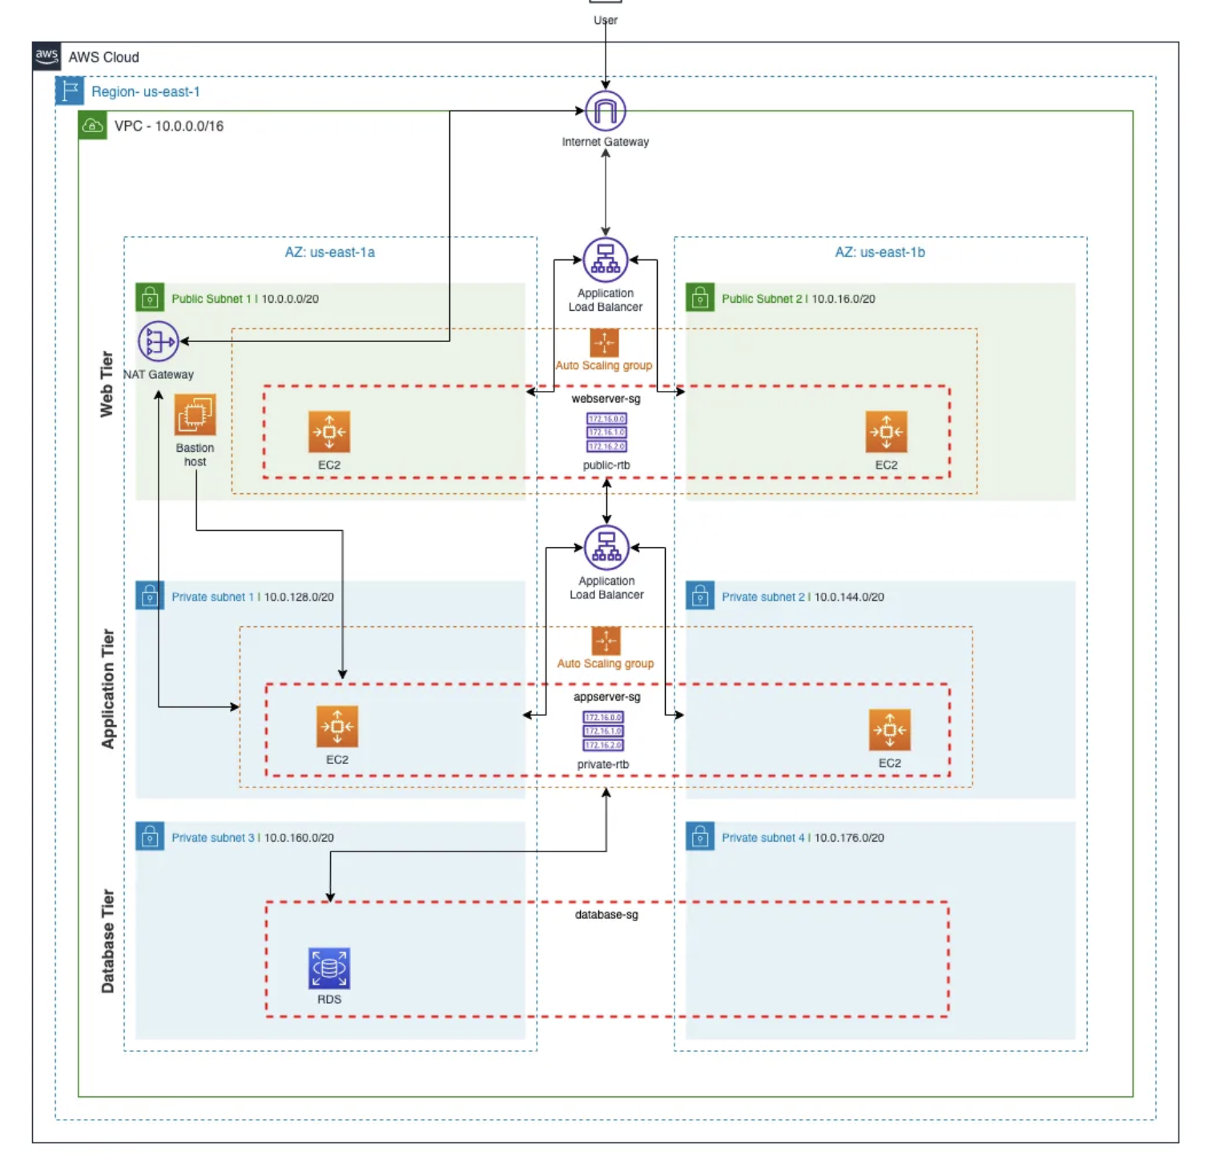
The three-tier web
application design

Slide 6
Components of Three-tier web application design
Public Subnet
ASG
EC2
NATGateway
ALB
VPC
Bastion Host
Internet Gateway
RDS Database
Private Subnet
ALB – Application Load balancer
EC2 – EC 2 Instance
ASG – Auto Scaling Group
VPC – Virtual private cloud
CRM
WEB APPLICATION COMPONENTS

Slide 7
AWS Services for the project
AWS S3 - For scalable storage. - WEB TIER
AWS EC2 - For scalable computing capacity. - APPLICATION TIER
AWS RDS Database - For managing relational databases. - DATABASE TIER
AWS VPC - For network management. - INFRASTRUCTURE TIER
AWS IAM - For managing user access. - INFRASTRUCTURE TIER
AWS Cognito - For user authentication. - APPLICATION TIER
AWS Cloudwatch – For monitoring - INFRASTRUCTURE TIER
AWS CloudFormation - For resource provisioning. - INFRASTRUCTURE TIER

Slide 8
AWS Tools and Resources Selection
1. AWS CloudFormation
Reasoning: AWS CloudFormation will be used to model and set up AWS resources for the CRM. This allows for easy management and provisioning of infrastructure as code.
Cost: CloudFormation itself is free, but there might be costs associated with the resources it creates.
2. Amazon RDS (Relational Database Service)
Reasoning: For the database, Amazon RDS is chosen due to its scalability, ease of management, and automatic backups.
Cost: Cost depends on the instance type, storage, and usage. For development purposes, the cost can be kept minimal by using smaller instance types like db.t3.micro.
3. Amazon S3 (Simple Storage Service)
Reasoning: S3 will be used for storing static assets (e.g., frontend HTML, CSS, and JavaScript files).
Cost: S3 has a pay-as-you-go pricing model. The cost will be minimal for the prototype stage.
4. Amazon Cognito
Reasoning: Cognito provides user sign-up, sign-in, and access control, making it suitable for managing user authentication and authorization.
Cost: Cognito offers a free tier with limited monthly active users, which is sufficient for the prototype.
5. AWS Lambda
Reasoning: Lambda will be used for backend functionality (e.g., processing user requests, handling form submissions). It's scalable and cost-effective for small-scale applications.
Cost: Lambda has a generous free tier, and costs are based on the number of requests and execution time.
6. Amazon API Gateway
Reasoning: API Gateway will expose RESTful APIs for the frontend to interact with the backend services.
Cost: API Gateway has a free tier, and costs are based on the number of API calls.

Slide 9
Development Process
Infrastructure Setup with CloudFormation
Define a CloudFormation template to set up RDS, S3, Cognito, Lambda, and API Gateway resources.
Deploy the CloudFormation stack to create and configure the necessary AWS resources.
Database Schema Design
Define tables for clients, contacts, account_history, deals, calls_log, emails_log, and reminders.
Use SQL scripts or ORM (Object-Relational Mapping) tools to create the database schema in RDS.
Frontend Development
Create HTML, CSS, and JavaScript files for the front page and table of contents.
Implement forms for inputting and displaying client information, contact details, and logs.
Store these static assets in S3.
Backend Development
Develop Lambda functions to handle CRUD operations for the database.
Create RESTful APIs using API Gateway to expose these Lambda functions to the frontend.
IAM Configuration
Set up Cognito user pools and identity pools for authentication.
Define IAM roles and policies to control access to AWS resources.

Slide 10
CRM System Using HTML CSS and JavaScript
We used HTML, CSS and JavaScript to create a basic, working CRM web application system.
There are seven pages which users can input data. Pages include Clients, Contacts, Account History, Deals/Opportunities, Calls Log, Emails Log and Reminders/Alerts.
On every page, there is a script which handles user input via a form and then it displays the user output below on the web page.

Slide 11
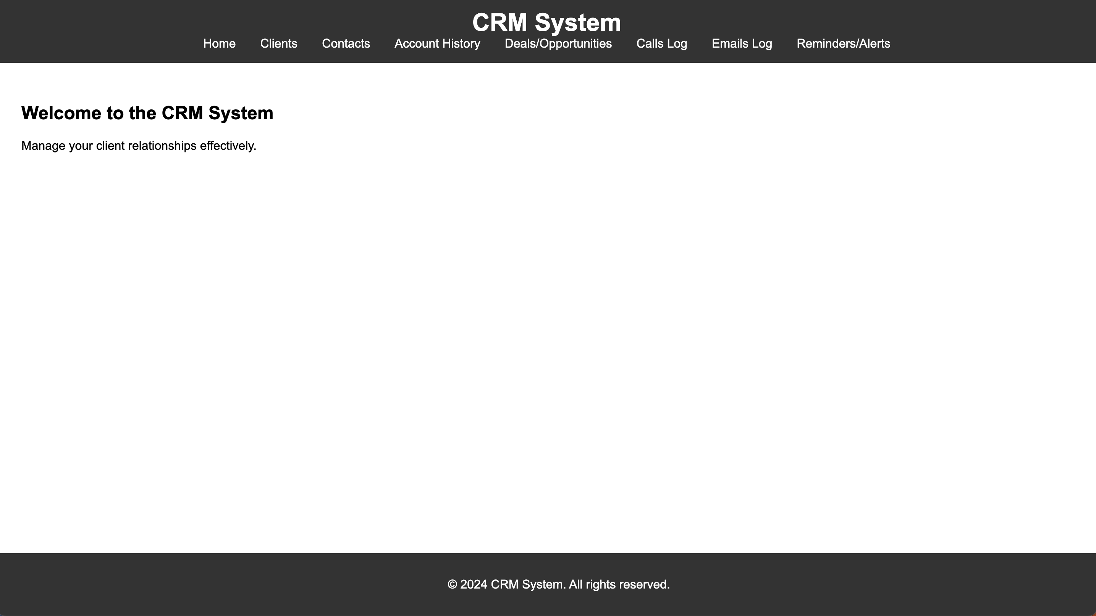
CRM System - Home page

Slide 12
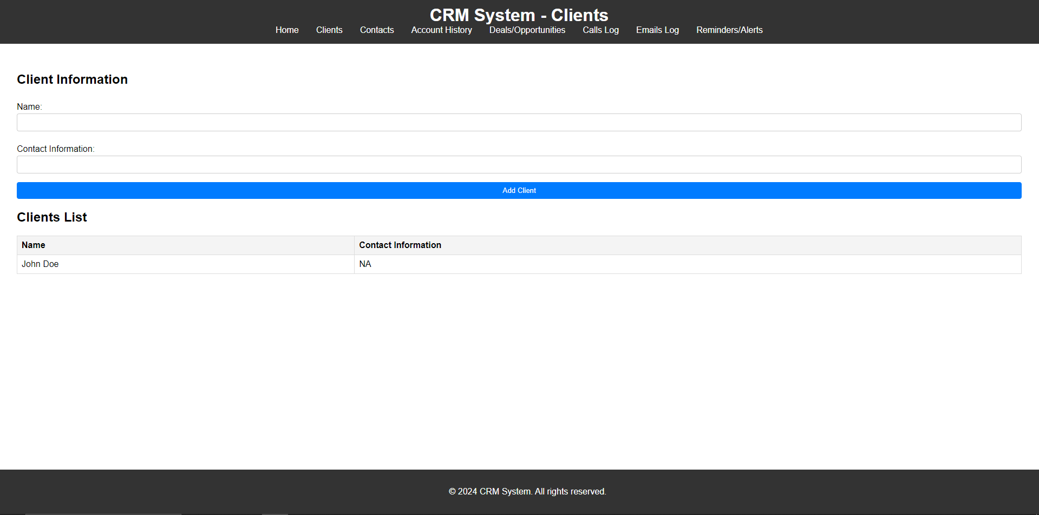
CRM System - Clients

Slide 13
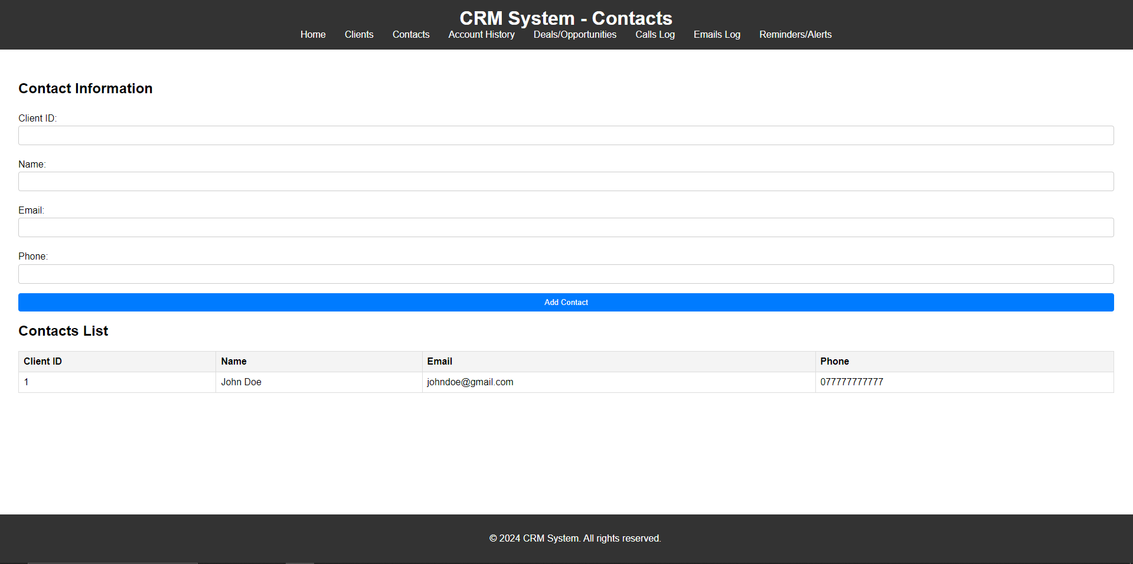
CRM System Contacts

Slide 14
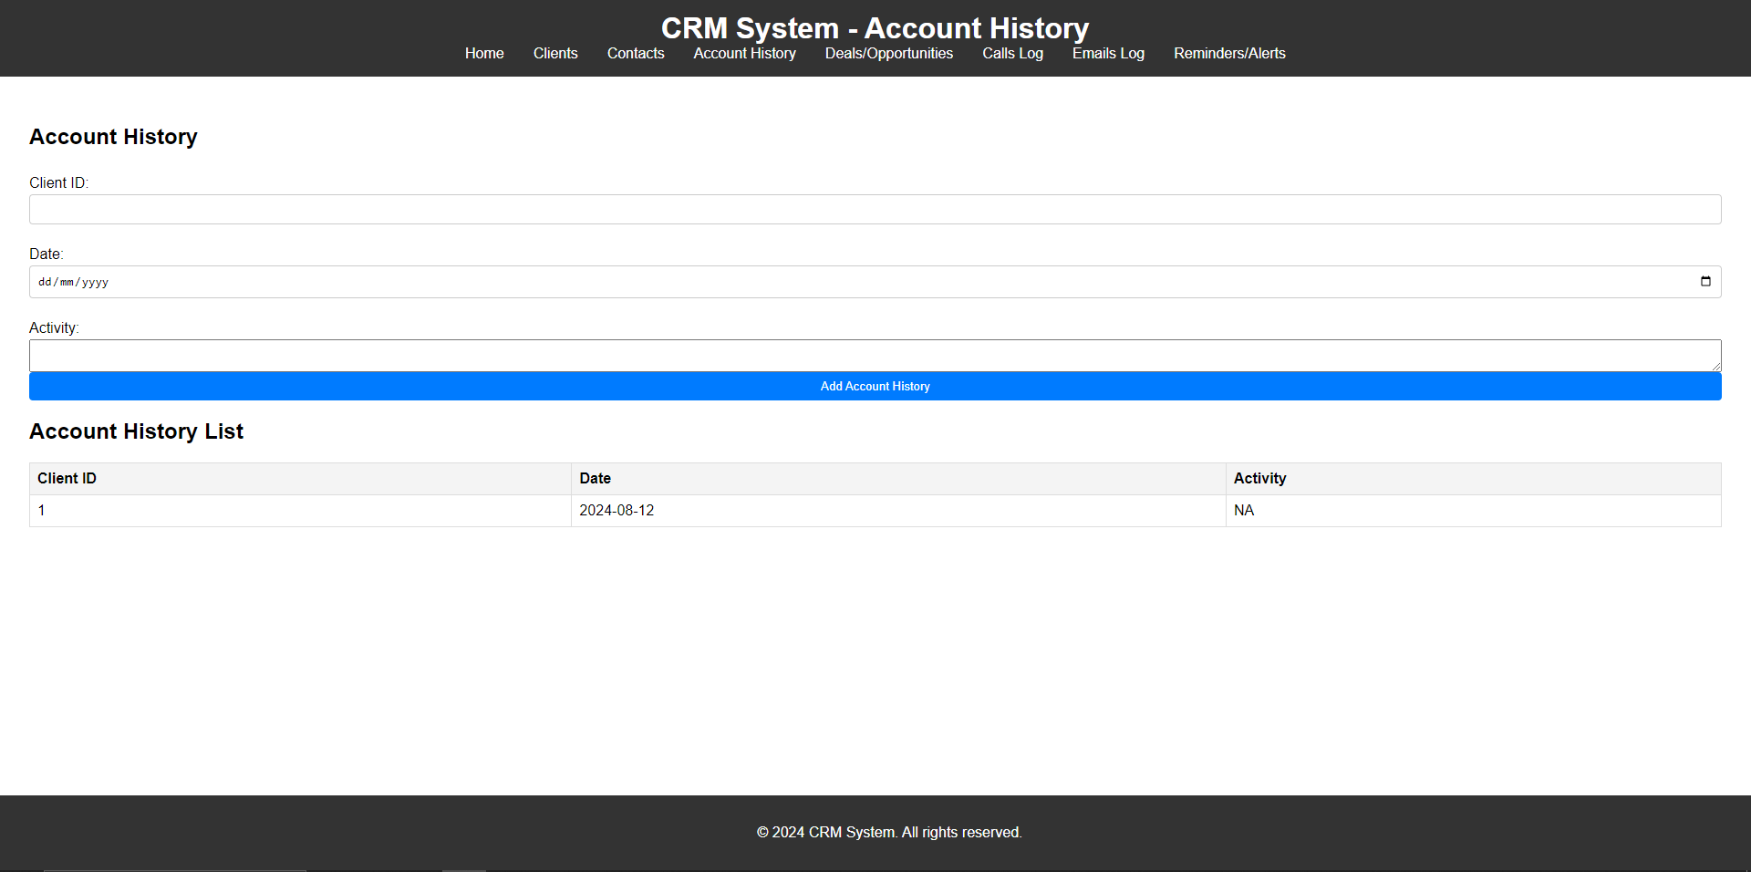
CRM Account History

Slide 15
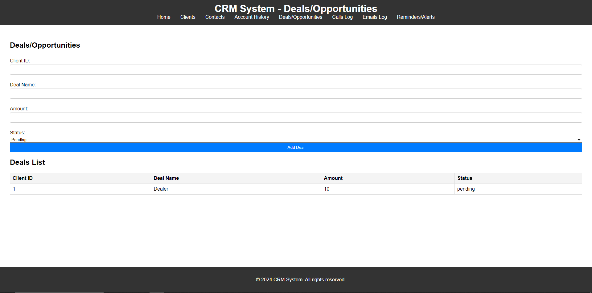
CRM System – Deals/Opportunities

Slide 16
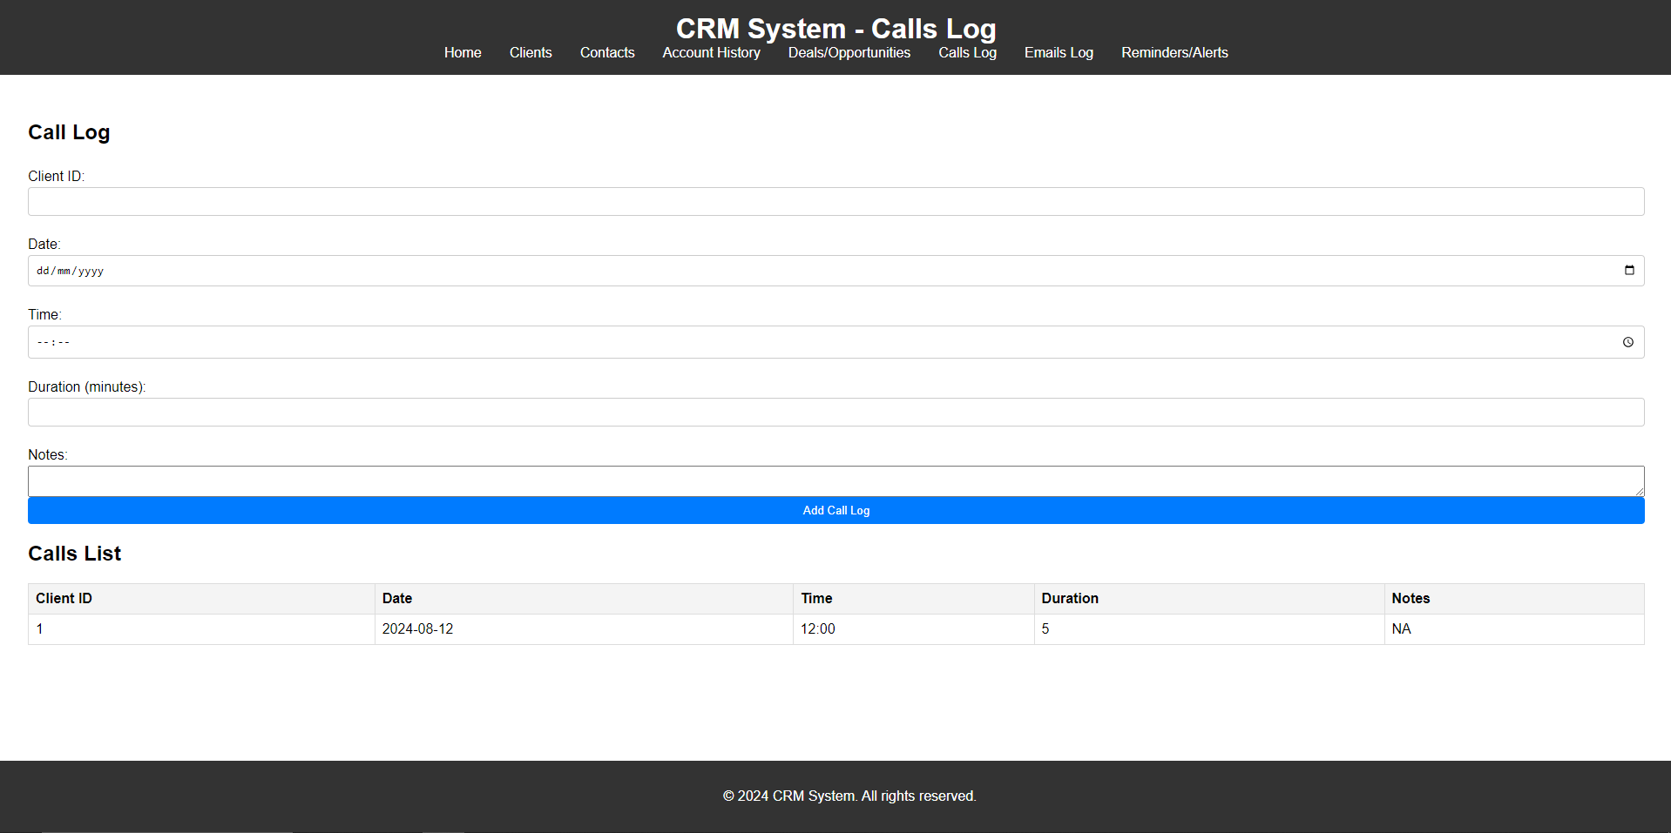
CRM System – Calls Log

Slide 17
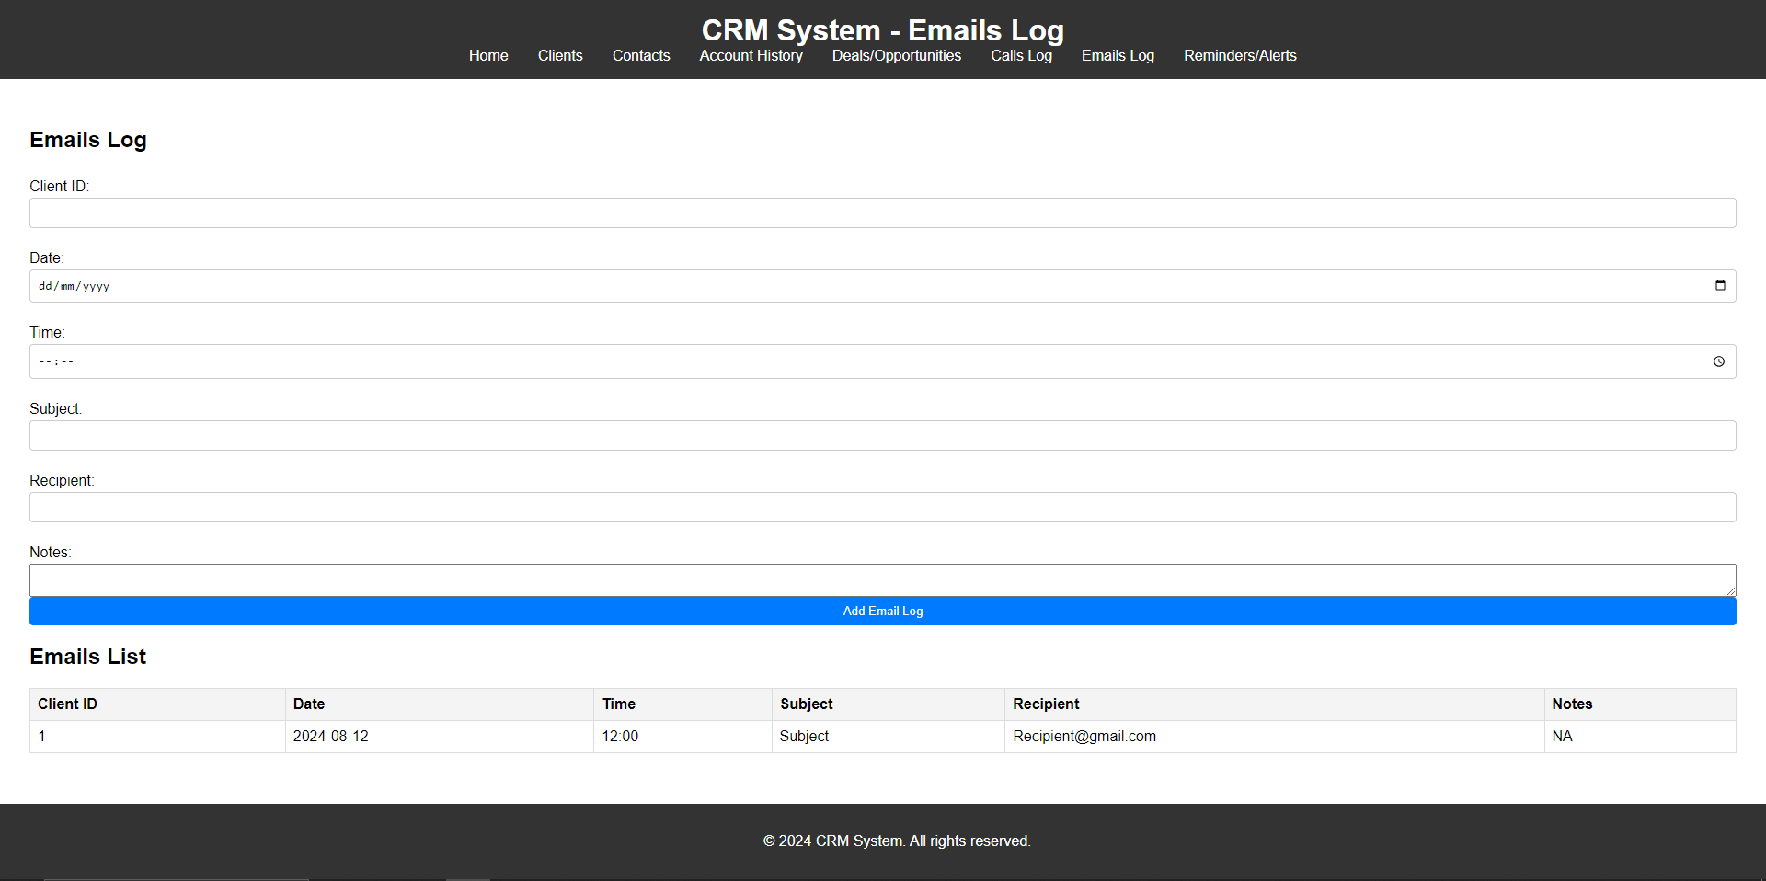
CRM System – Emails Log

Slide 18
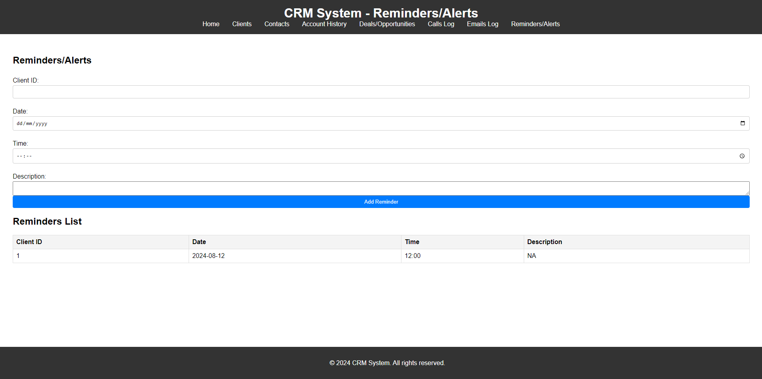
CRM System – Reminders/Alerts

Slide 19
Backend Code (AWS Lambda Function)
Backend code will be deployed to AWS Lambda to handle the API requests and interact with the MySQL database.
Backend Code (AWS Lambda Function) lambda_function.js:
Connects to the MySQL database using the mysql module.
Defines an AWS Lambda handler function to process incoming HTTP requests and perform CRUD operations.
Includes functions to get all clients, get a specific client, add a client, update a client, and delete a client.

Slide 20
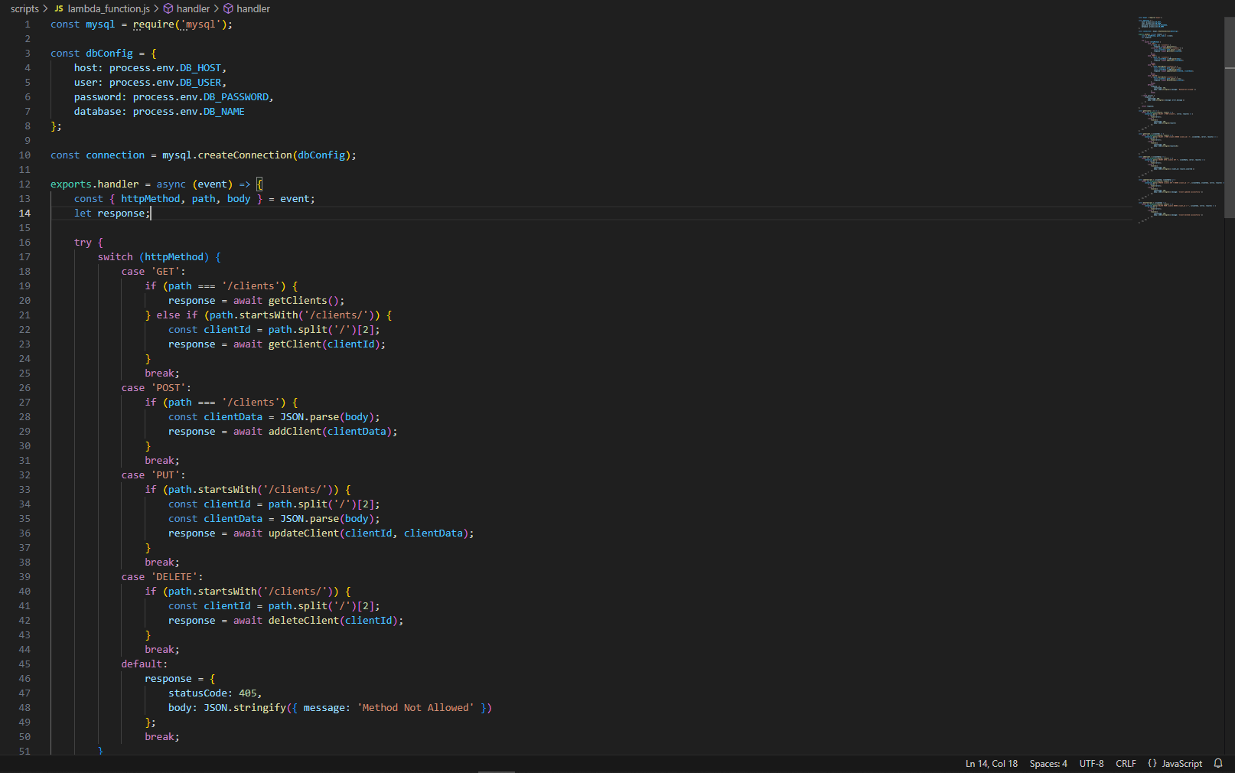
Backend Code lambda_function.js

Slide 21
Frontend Code (JavaScript for CRUD Operations)
The index.js file for the frontend handles interactions with the backend API and updates the user interface accordingly.
Defines utility functions to make API requests to the backend endpoints.
Implements functions to create, read, update, and delete client entries.
Adds event listeners to form submissions to handle user interactions and update the UI accordingly.

Slide 22
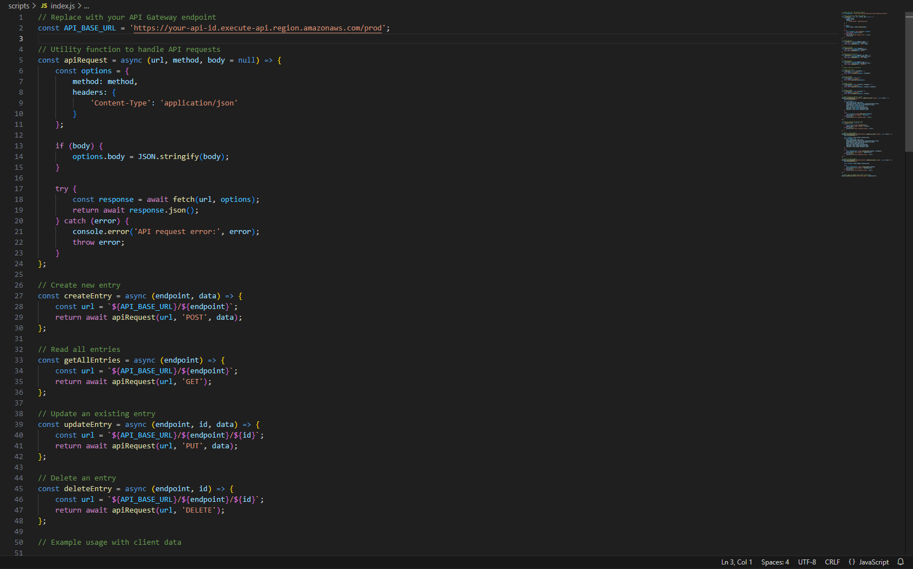
Frontend Code index.js

Slide 23
Conclusions
We have been able to meet the project brief and create a fully functional CRM model using AWS resources via Cloudformation. Our complete report addresses all of the points below in terms of evaluating our model. It is the decision of CGI to decide if our model will be utilized by them given the areas that we have clearly laid out by which our model will be judged against.
Functionality
Cost
Scalability
Latency/Availability
Storage
Notes:
Functionality - How user friendly is the CRM? Can it be edited easily?
Cost - Does the CRM exceed our budgeted cost projection? We intend to explain if yes/no?
Scalability – Can the CRM be expanded to a wider network, audience, we will monitor this
Latency/Availability - Can we access the CRM without delay? Are there issues with downtown
Storage – Does the CRM hold and retain data effectively? Are there issues in terms of data loss?

Slide 24
Evaluation
What would we do differently moving forward and what have we learnt as a team? - Time constraints (Time given to evaluate existing CRM systems pros and cons to incorporate into our system)
Developed a thorough understanding of Cloudformation as an an automation tool for building effective web application infrastructure that can be accessed through the internet.
A challenging and ultimately rewarding project. Testing areas of our expertise and fully utilized what we have learnt through the duration of the bootcamp so far
A big thanks to the project team, co-ordinators and everyone involved in this project!

Slide 25
Thank you for listening! Any questions?
0161 686 5770
info@in4group.co.uk
Twitter @IN4Group
www.in4group.co.uk

